Slide 1
LOST DOG

Slide 2
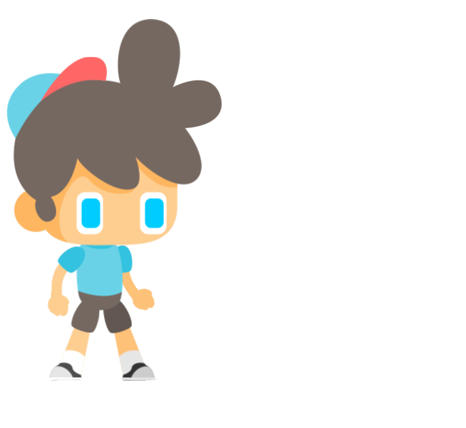
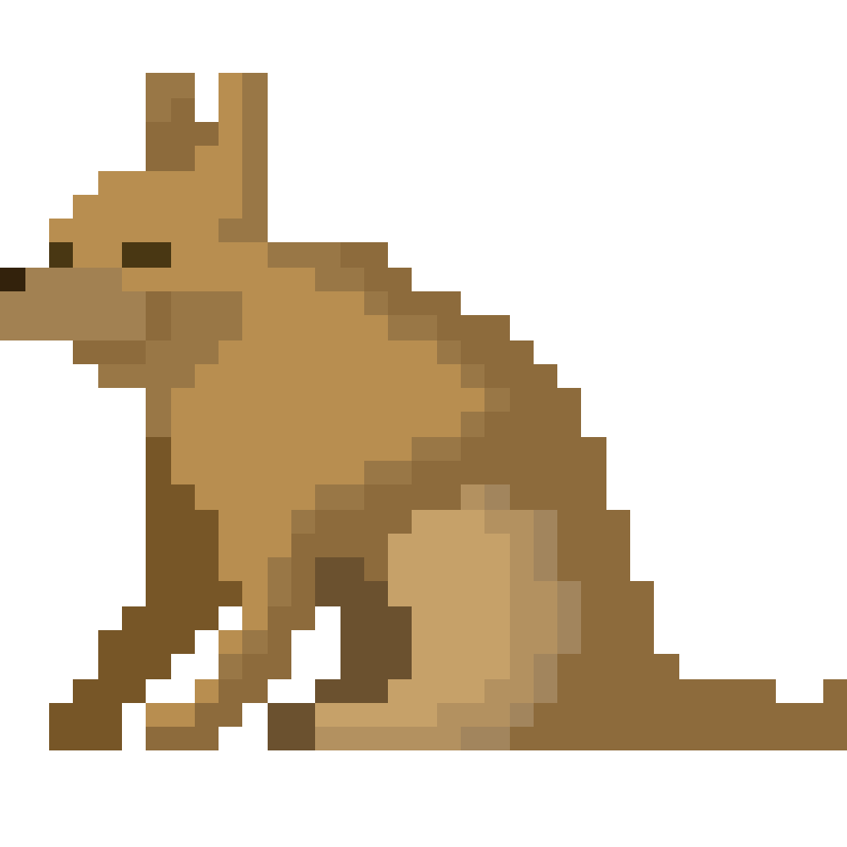
MAIN CHARACTER AND STORY
MAIN CHARACTER
Story behind this boy is losing his best friend, a dog, somewhere in the woods.
While trying to find a way to his dog he will come across many obstacles along the way.
That includes a lot of difficulte approaches through some paths and also different enemies.

Slide 3



ENEMIES
Turtle
.
Turtle is first level enemy and it is slow.
Centipede
Centipede is second level enemy and it is fast.
Monster
Monster is highest level of enemy and it is big and fast

Slide 4


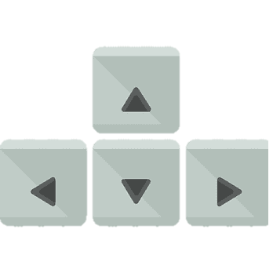
CONTROL AND ENGINE
As it is 2D platofrmer, controls were planned with arrow keys. Boy had no actions but running and juming.
Jumping on enemies would destroy enemy, but also when enemies hit the boy, he will lose one „game life“.
Godot enigne was used as it is simple and easy to use for early stage game developing, also provides a lot of possibilites even with 2D developing.

Slide 5
Thank you for attention and enjoy the game demo

